Slide 1


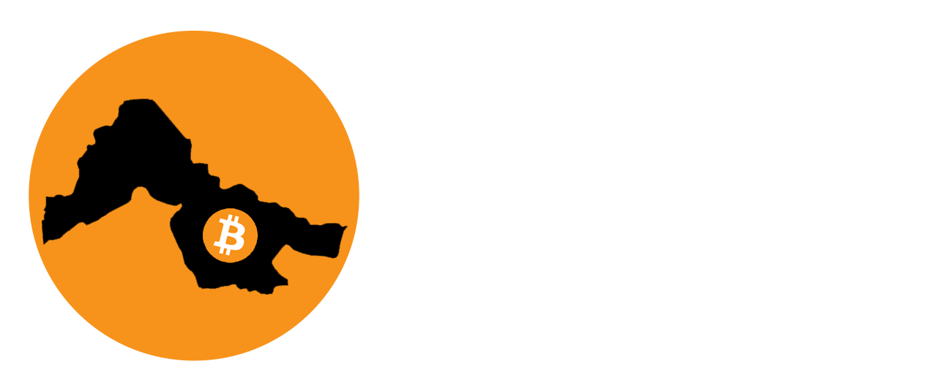

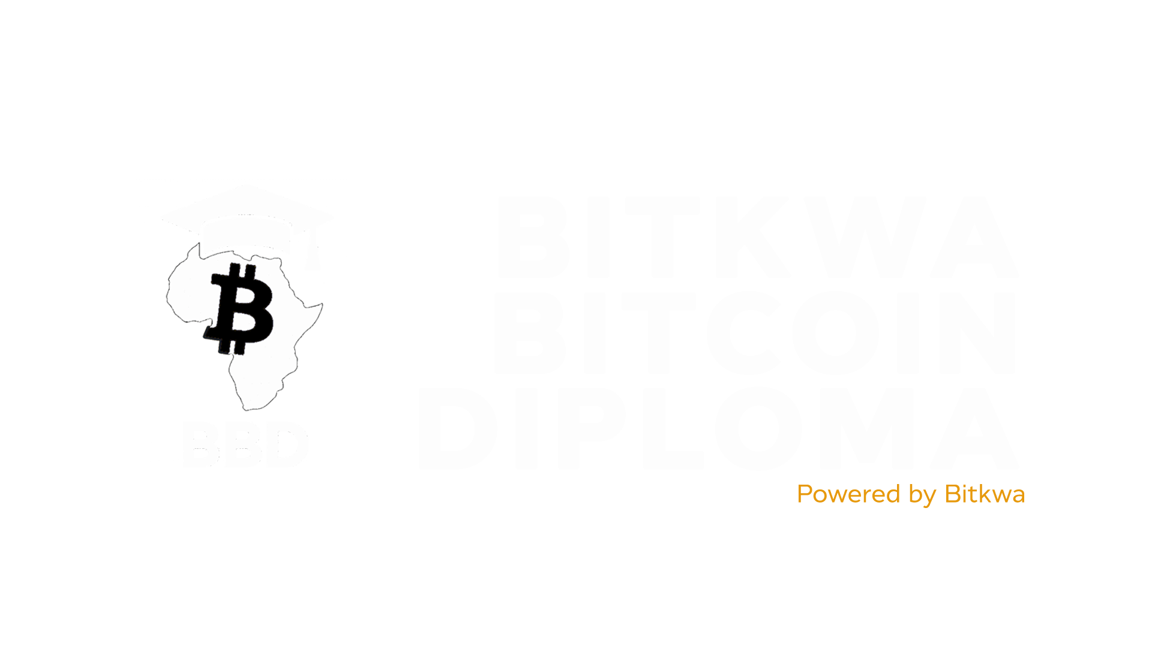
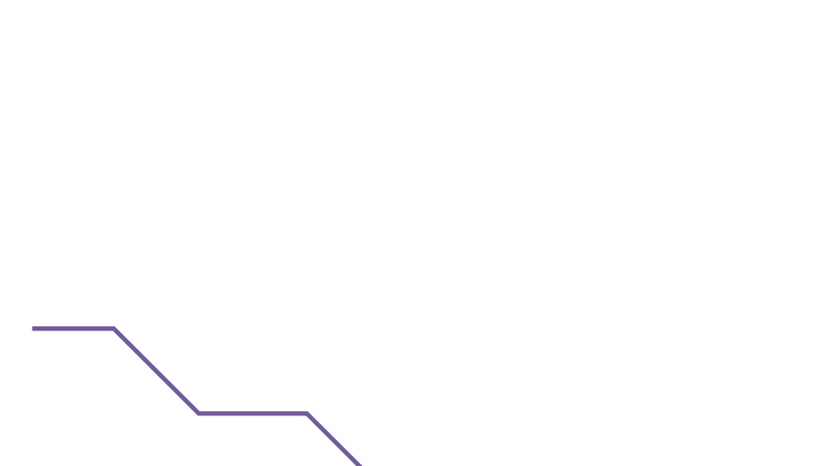

Slide 2
Chapter #1
MONEY
History, What It is, & Why We Need it

Slide 3



History of Money?

Slide 4

The History of Money
Money was not evolved by design but arose out of the market process. It was not created by governments. It emerged over time as a spontaneous
Murray Rothbard
Imagine a time long ago when people didn't have the coins or paper bills we use today. Back then, they had a unique way of trading things — using items like shells or precious metals like gold as a kind of special currency. This might sound strange, but it was their version of money, something everyone agreed had value.

Slide 5












The History of Money
Paper Money
Bretton
Woods
System
Electronic Money
Gold
Barter System
9,000 BCE
Metal Coins
700 BCE
1945—1971
Plastic Cards
1959
Bitcoin
2009
Imagine a time long ago when people didn't have the coins or paper bills we use today. Back then, they had a unique way of trading things — using items like shells or precious metals like gold as a kind of special currency. This might sound strange, but it was their version of money, something everyone agreed had value.

Slide 6


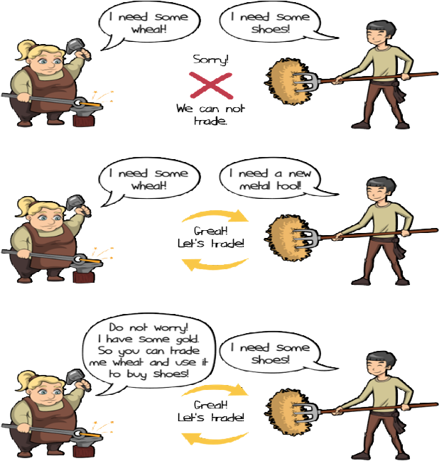





The History of Money
Chapter #3
Round #1- Barter
It is the year 6000 B.C.E. Needless to say, money as we know it has not been invented. You are in Mesopotamia and directly exchange goods and services with one another through bartering.
Round #2 - Commodity Money
Fast-forward and travel to the western coast of Africa sometime around the 14th century BCE. Bartering has become tedious and ineﬃcient. We have evolved as a civilization and are now using commodity money.
Cowry Shells to Coins
1300 BCE
1000 BCE
687 BCE
FUN FACT
Cowry shells were accepted as legal tender in some parts of Africa until the 20th century.

Slide 7






The History of Money
Chapter #3
Let’s suppose:
Joseph wants to trade his banana for Yael’s coconut.
But Yael only wants to trade her coconut for Tammy’s mango.
And Tammy only wants to trade her mango for Joseph’s banana.
They are stuck in a never-ending cycle of fruit trading without a double coincidence of wants.
Joseph suggests they just trade their fruits for a nice cold soda, but they realize they are on a remote island and there is no soda.
They decide to just sit on the beach and enjoy their fruits in silence.
Commodity money is money made from valuable metal materials like gold and silver. These have historically been used as a store of value, a medium of exchange, and in the distant past a unit of account.

Slide 8


The History of Money
Chapter #3
Transition from Sound to Unsound Money
Fast-forward to the 17th century in Sweden. Now you are completely dependent on banks to store your valuable assets. However, you start to notice something ﬁshy going on with these bankers. It seems they are issuing more paper receipts than they have gold in storage, allowing them to create more money than they have assets to back it up. This sneaky practice allows the bankers to proﬁt from the diﬀerence between the value of the paper receipts and the value of the gold they are holding for their customers.
You realize that this marks a major shift in the way money works. You are moving from a system of sound money (i.e. money backed by precious metals) to a system of unsound money (i.e. ﬁat currency not backed by a physical commodity). This transition didn’t happen overnight, but rather was a gradual process inﬂuenced by several factors. The industrial revolution, with its mass production and urbanization, played a role, as did the growth of advanced ﬁnancial systems like banks and stock markets. The emergence of central banks and other monetary authorities contributed to the centralization or the control of money, leading to the issuance of ﬁat currencies to support economic growth.
However, you also begin to see the downsides of this centralization, including irresponsible consumption, increase in debt, and manipulation of citizens through economic incentives.

Slide 9








The History of Money
The History of Money
Chapter #3
Bretton Woods System
(1945—1972)
Until World War I, you were able to convert your paper money into a preset amount of gold. But the two world wars and the 1929 economic crisis put an end to that. In 1944, the Bretton Woods agreement was signed, establishing the U.S. dollar as the world’s reserve currency and ﬁxing the value of the U.S. dollar to the price of gold at a rate of $35 per ounce. Other countries’ currencies are pegged to the dollar, which helps to stabilize international ﬁnancial markets.
German mark
British pound
French franc
Par Value
Par Value
Par Value
Unfortunately, the system began to break down in the late 1960s, leading to the Nixon Shock in 1971, when the US government suspended the dollar’s convertibility into gold. This marked the end of the gold standard and the beginning of a world driven by the creation and accumulation of debt.
As you go about your daily life, you begin to notice that the value of money is no longer as stable as it used to be.
Just like a ﬂexible ruler makes it diﬃcult to accurately measure the length of a table, living in a ﬁat world where the value of money is subject to the unpredictability of those in power can also make it diﬃcult to accurately measure the value of goods and services. You feel confusion and unease adjusting to a world where the value of money is no longer tied to a physical commodity like gold
US Dollar
Pegged at $35/oz.
Gold

Slide 10
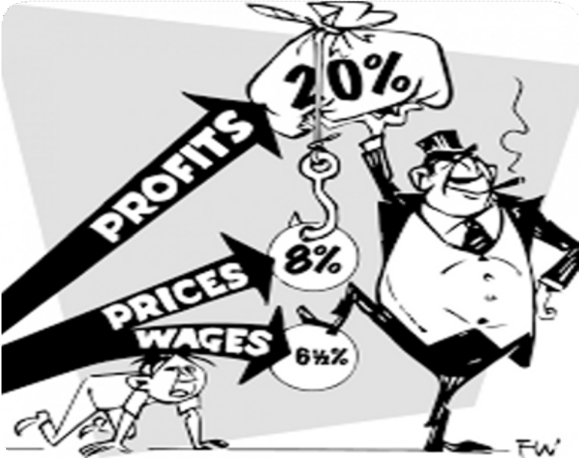
The History of Money
Chapter #3
Abuse of centralization.
Rising prices
Stagnating real wages.
Weakening currencies.
The need to spend more money for fewer things.
This creates challenges for those with lower economic resources, who may have limited access to education, credit, resources, social networks, and political representation, leading to potential disadvantages in their ability to succeed.
As a result, the rich seem to keep getting richer and the poor seem to keep getting poorer.

Slide 11







The History of Money
The History of Money
Chapter #3
Paper to Plastic
Today, we’ve come a long way from the introduction of the ﬁrst credit card back in the 1950s. With a simple swipe of plastic, we can buy whatever we want, whenever we want, without any hassle. It’s like opening up a world of endless possibilities, and the excitement of discovering what it holds is palpable... or so we thought. Little did we know that our reliance on credit would have painful aftereﬀects — like raising the overall cost of goods and incentivizing a certain economy doomed to fail.
Network Fee
BANK
$1.52
BANK
$0.48
INTERCHANGE RATES
As technology advances, so does the way we handle money. The internet has become a major player in the ﬁnancial world, with online banking and e-commerce websites making it possible to manage and spend money entirely online.
The rise of digital money marks the next signiﬁcant leap in this evolution, oﬀering new possibilities and reshaping the way we make ﬁnancial transactions.
CARD HOLDER
$100
MERCHANT
$98

Slide 12
The History of Money
The History of Money
The History of Money
Chapter #3
Digital Currency
Unlike traditional ones, exist solely in electronic form. They are stored and exchanged using computers and special software.
Digital currency allows individuals to send their money through the internet. Much like how email allows us to send messages instantly and without shipping costs, digital currencies allow us to send and receive value instantaneously and at very little cost.
The currencies we use today are becoming more and more digital. Only a small fraction of the money supply actually exists in the form of coins and paper bills. Banks and banking services provide their users with applications to seamlessly exchange money over the internet. But where is the money coming from?
We've witnessed the transformation from sound money, represented by gold, to unsound money in the form of paper, and now, digital ﬁat currency. In the next chapter, we'll explore how the current ﬁat monetary system works and how it came to be.

Slide 13
What is Money?

Slide 14


What Is Money?
Introduction
Money is a guarantee that we may have what we want in the future. Though we need nothing at the moment, it ensures the possibility of satisfying a new desire when it arises
Aristotle
Deﬁnition of Money
Have you ever stopped to think about what money really is? Ever wonder what makes money…well, money? Most of us know how to use it, but not many of us understand where it comes from or how it works. Money is essentially a way to exchange goods and services. It represents the value of these items in a form that can be easily traded. This can take many diﬀerent forms, such as paper notes, metal coins, and electronic payments. Governments or other authorities typically issue and control money, but money is so much more than just a physical or digital medium of exchange; it’s like a universal language that allows us to trade with people all around the world, even if we don’t speak the same language or have the same culture. For example, you can be on the other side of the world and still “speak” money by placing a product on the counter and exchanging it for the local currency or using a credit card.
13

Slide 15


What Is Money?
What is Money
Chapter #2
Money is like a social contract that allows us to make exchanges without having to rely on bartering or ﬁnding someone who speciﬁcally wants what we have to oﬀer. If a group of people started accepting chocolate as payment for most goods and services, chocolate would become money (although, since it would melt in some parts of the world, we might consider it bad money).
As French economist Jean-Baptiste Say pointed out, “Money performs but a momentary function in an exchange; and when the transaction is ﬁnally closed, it will always be found that one kind of commodity has been exchanged for another.”
In other words, money itself doesn’t have the power to satisfy human wants; it’s just a tool that allows us to trade one commodity for another.
A Transaction is an exchange or transfer of goods and services. It is a way of exchanging value between two or more parties.
There are many diﬀerent types of transactions, ranging from simple exchanges (such as buying a sandwich at a deli) to more complex ﬁnancial transactions (such as buying a house or investing in stocks or bonds). Transactions can be conducted in person, over the phone, online, or through other means, and they can involve a wide range of parties, including individuals, businesses, and ﬁnancial institutions.
14

Slide 16

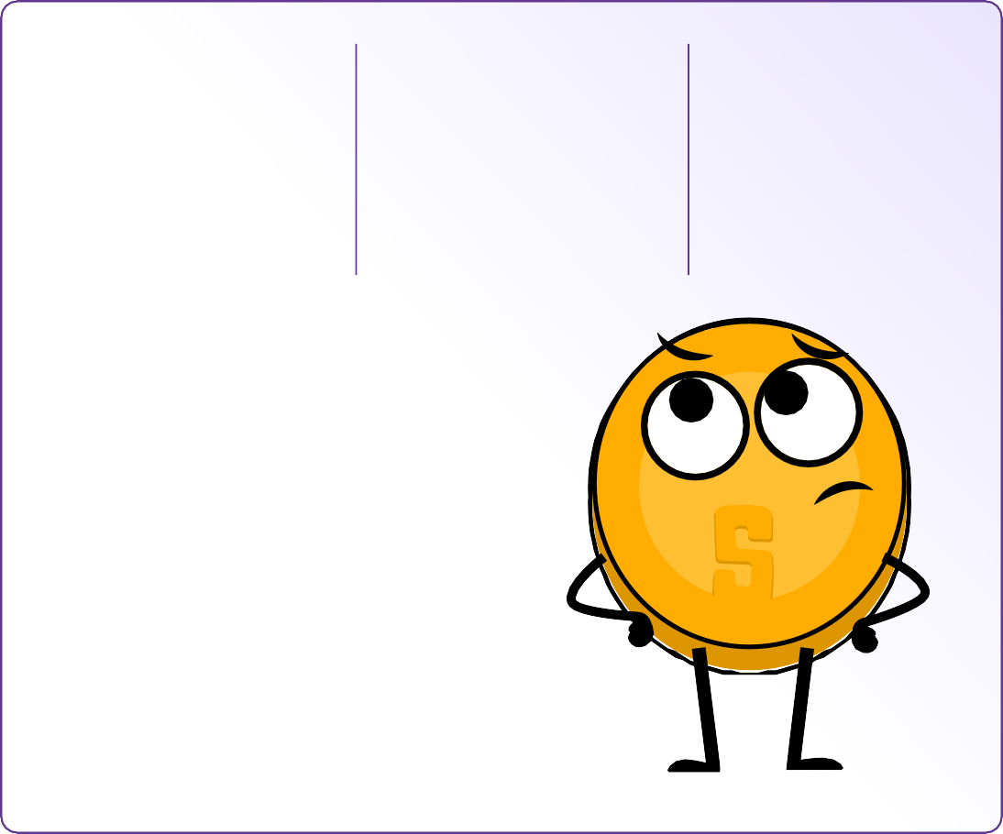

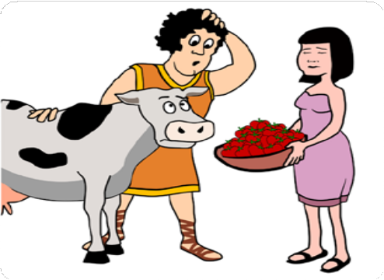
What Is Money?
What is Money
Chapter #2
Without money, how easy or feasible would this trade be?
Would you trade one cow for 1 million
strawberries?
Or 600,000
strawberries? How about 50,000?
Money IS the value BY which goods are exchanged.
Money IS NOT the value FOR which goods are exchanged.
In summary, money:
Facilitates trade because everyone accepts it as ﬁnal payment. It also allows us to measure value and compare diﬀerent goods and services. Next, we’ll look at the function of money.
15

Slide 17




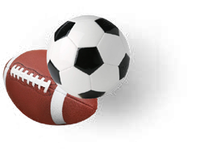
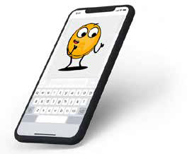



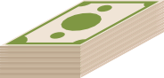




What Is Money?
Function of Money
When it comes to buying and selling goods and services, money is the key player. Money serves several important functions in the world, like:
Unit of Account
Money provides a universal standard of value that allows people to express and compare the price of diﬀerent goods and services. This allows for a more eﬃcient and transparent market, where people can make informed decisions about what to buy and sell.
3
Store of Value
Money should maintain its value over time, making it useful as a method to save and invest the value of human labor. This lets people use money to plan for the future and borrow and lend money. So, the next time you’re saving up for something special, remember that money is more than just a way to pay for things,
1
Unit of Account
Consumers know the value of something when you assign a price (monetary value) to it.
$29.00
$350.00
 | BTC (USD) | Gold (USD) | USD (EUR)
March 14, 2019 | $3,846 | $1,293 | €0.8817
March 14, 2020 | $5,258 | $1,529 | €0.90056
Gain/Loss | +36.71% | +18.25% | +2.14%
What’s your store of value?
Think of it like this: if you wanted to buy a new car, you could compare prices from diﬀerent dealerships and make an informed decision about which one to buy based on the price in dollars. Without a unit of account, you’d have to try to compare the value of one car to another using something else, like the number of cows it was worth or the length of time it took to make the car.
These three functions are what allow economies to become complex and dynamic. Without money, it would be much harder to buy and sell goods and services, and our economy would be much less developed.
Medium of Exchange
With money, you don’t have to ﬁnd someone who wants exactly what you have to trade. Instead, you can use money to buy and sell anything you want. This makes trading and commerce much more convenient and eﬃcient.
2
Medium of Exchange
16

Slide 18
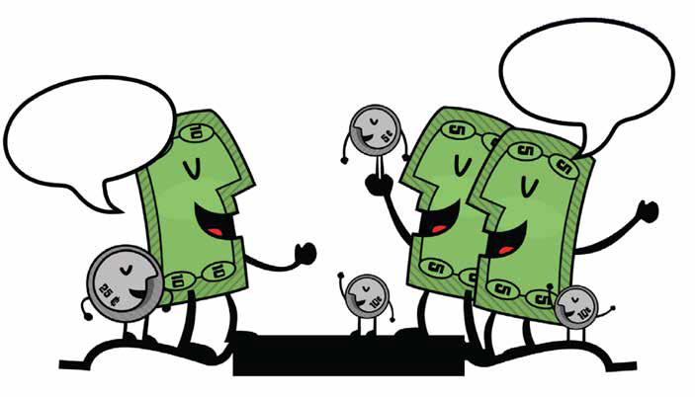


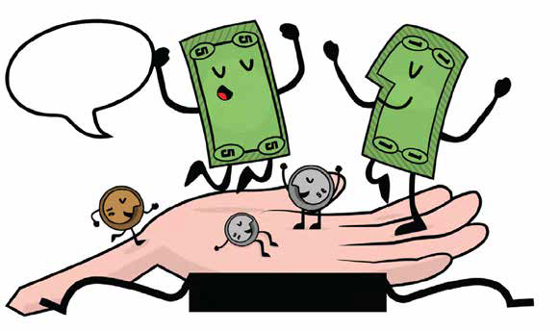
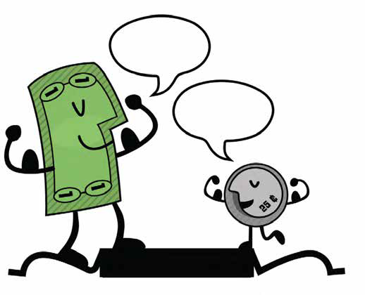
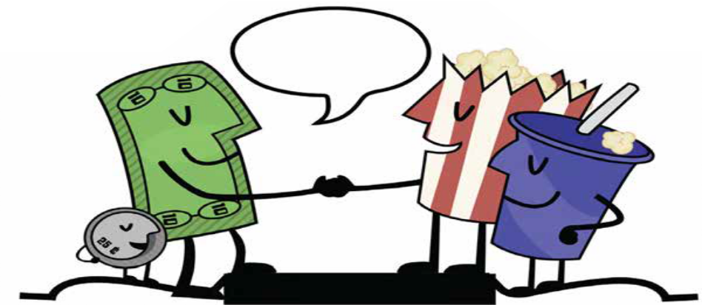

What Is Money?
What Is Money?
What is Money
Chapter #2
Properties of Money
Over time, people have ultimately realized that money must possess certain qualities to be eﬀective as a medium of exchange. These characteristics include durability, divisibility, portability, acceptability, scarcity, and fungibility.
Divisibility refers to money’s ability to be divided into smaller units so that people can use it to make purchases of varying amounts. Paper bills can be easily divided into smaller denominations, making them a good representation of money’s divisibility characteristic.
We are change!
Got
Change?
DIVISIBLE
Durability refers to money's ability to resist physical deterioration and last over time. This ensures that money can circulate in the economy in an acceptable and recognizable state. Gold is a durable material that can withstand wear and tear, making it a good representation of money’s durability characteristic.
Portability refers to the ease with which money can be transported and carried around. This allows people to use money to buy and sell goods and services without diﬃculty. Credit cards are portable, as they can easily be carried in a wallet or purse, making them a good representation of money’s portability characteristic.
Field ^{trip!}
Thanks!
PORTABLE
Wanna
trade
Looking good!
Acceptability refers to the widespread acceptance of money as a form of payment so that people can use it to buy and sell goods and services with conﬁdence. The US dollar is widely accepted as a form of payment, making it a good representation of the acceptability characteristic.
places?
ACCEPTABLE
DURABLE
17

Slide 19

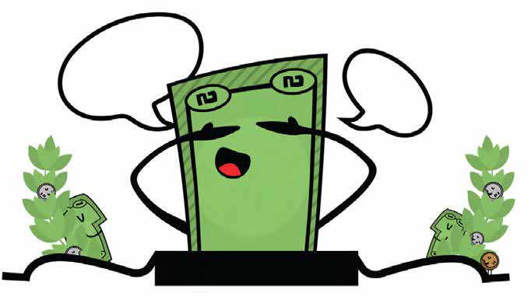

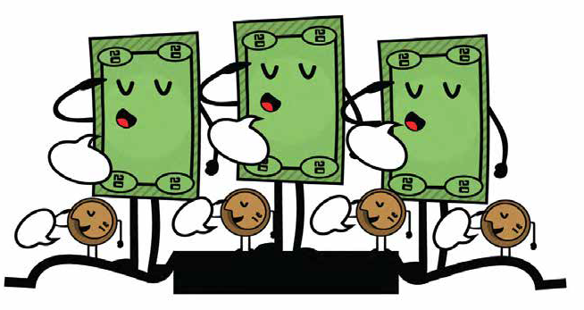
What Is Money?
What Is Money?
What Is Money?
What is Money
Chapter #2
Scarcity refers to the limited supply of money, which helps maintain its value and prevents us from having to spend more money to buy the same amount of goods. Collectible stamps, especially rare and valuable ones, can be a good form of money because they are scarce and can appreciate in value over time. Stamp collectors often use their stamps as a way to invest their wealth and diversify
their portfolio.
Fungibility refers to the interchangeability of money so that one unit of money is equivalent to another unit of the same value. Money should be uniform. Copper coins are uniform in size and weight, making them a good representation of money’s uniformity characteristic. One cent is always one cent.
Ready or not
Here I Come!
1..2..3..
SCARCE
$20!
$20!
$20!
1¢!
1¢!
1¢!
1¢!
UNIFORM
Overall, these characteristics make money a useful and eﬀective tool for facilitating trade
and commerce, and they are essential for economic development and stability.

Slide 20



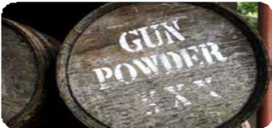
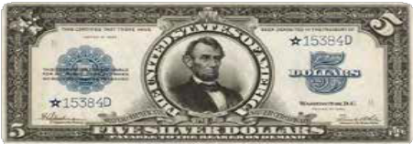
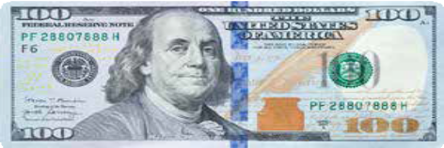




What Is Money?
What Is Money?
What Is Money?
What is Money
Chapter #2
Types of Money
Money can be divided into two main categories: physical and digital.
Commodity Money
Representative Money
Fiat Money
Not all money is the same!
Physical money includes:
Fiat money, which is the paper bills and coins issued by governments and accepted as a medium of exchange.
Representative money, which represents a claim on a physical commodity.
Commodity money, which is a physical object that has intrinsic value and is
widely accepted as a medium of exchange — for example, gold and silver.
Objects like this gun powder once served as commodity money.
Representative money like this silver certiﬁcate could be exchanged for silver.
Today, Federal Reserve notes are ﬁat money, decreed by the federal government to be an acceptable way to pay debts.
Digital currencies, on the other hand, can be used for online transactions and include electronic currencies, stablecoins, and cryptocurrencies.
Electronic currencies are digital versions of regular money, like dollars or euros, and can be used to buy and sell things online via digital payment rails.

Slide 21
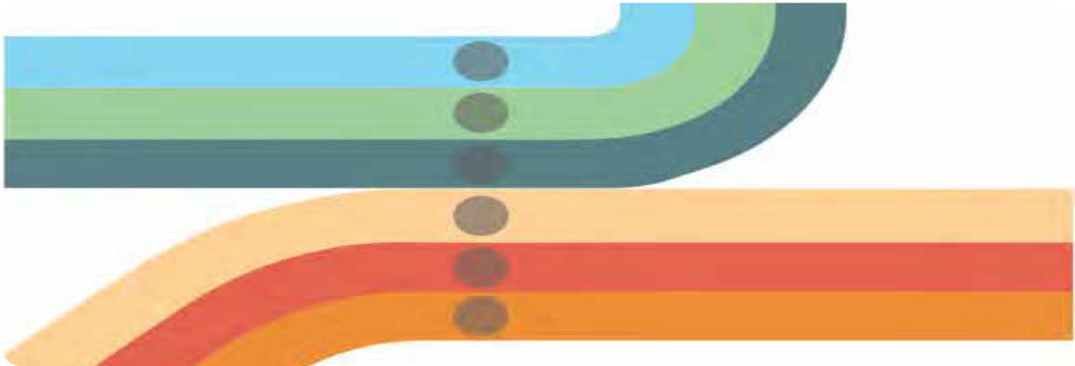
What Is Money?
What Is Money?
What Is Money?
What Is Money?
What is Money
Chapter #2
Payment rails are the infrastructure enabling the movement of electronic currencies and other digital assets from one place to another. However, in the traditional ﬁnancial system, there is always a middleman, such as a bank or other ﬁnancial institution, that charges a fee and has the authority to accept, cancel, revert, or delay transactions.
Cash ACH
Checks
Wire Transfer Card Networks Crypto
In the intermediated ﬁnancial system, the main types of digital payment rails include card networks — which facilitate the transfer of funds between ﬁnancial institutions and merchants when a customer makes a purchase using a debit or credit card — and digital wallets, which are online accounts that allow users to store and manage their electronic currencies and make payments by transferring funds from their account to the recipient’s account.

Slide 22





What Is Money?
What Is Money?
What Is Money?
What Is Money?
What is Money
Chapter #2
Central Bank Digital Currencies (CBDCs)
Digital versions of a country’s ﬁat currency, which are issued and backed by the central bank and
intermediated by the government.
Stablecoins
Digital currencies designed to maintain a stable value relative to an asset, like the US dollar
Cryptocurrencies
A type of digital currency. Some cryptocurrencies are decentralized and governed by rules, while others are centralized and controlled by a small group of people.
Ultimately, a currency that operates without intermediaries is more eﬃcient and beneﬁcial for society, as it prevents a few individuals from controlling the money supply and concentrating their power. However, creating such a currency that facilitates secure transactions without relying on trust between parties has been a challenge throughout history. To achieve this, a currency must be created that operates like the internet, where control is distributed among everyone and no one at the same time. This requires the agreement of all parties, including those who hold power, to relinquish control for the greater good.

Slide 23


What Is Money?
What is Money
Chapter #2
The Psychology of Money: Scarcity,
Time Preference, and Trade-Oﬀs
Imagine you are stranded in a desert and you only have one bottle of water left. You are thirsty and desperate for a drink, but you also know that you will need the water to survive until you can ﬁnd more. This is a classic example of scarcity — you only have a limited amount of a resource (water) and you must make a choice about how to use it. In this situation, you might decide to ration it and take small sips over a longer period of time to make it last as long as possible.
Scarcity forces us to weigh the pros and cons of how we use our resources and make trade-oﬀs.
Alternatively, you might decide to drink as much as you can in one go, hoping that the burst of hydration will give you the energy you need to ﬁnd more water. Regardless of which choice you make, you are faced with a diﬃcult decision. In this case, the choice is between quenching your immediate thirst and conserving the water for later. This concept of scarcity applies to all kinds of resources, not just water. Whether it’s money, time, or even love and attention, we are constantly faced with choices about how to allocate our limited resources.

Slide 24
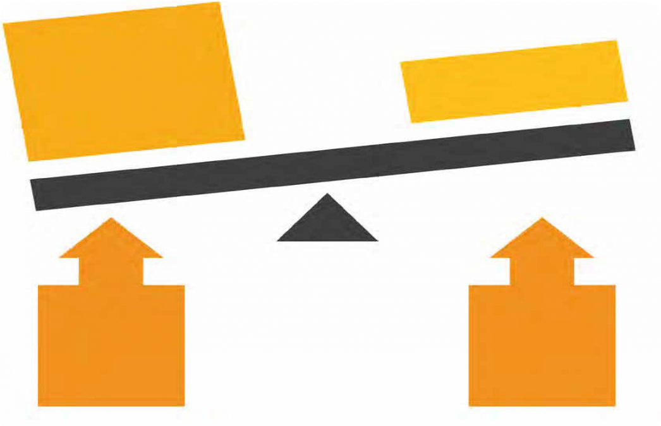


What Is Money?
What is Money
Chapter #2
There are two types of scarcity
Human-made scarcity, also known as centralized scarcity, includes things like limited edition designer bags, rare sports cards, and numbered art pieces. These can be easily replicated or counterfeited.
Natural scarcity, also known as decentralized scarcity, includes things like salt, shells, and precious metals like gold. These are harder to replicate or counterfeit. The main diﬀerence between the two is control.
We want food, fun, travel, home, cars, drugs, jewelry, etc.
Land, Labor, Capital, Enterprise
VIRTUALLY LIMITLESS HUMAN WANTS
LIMITED RESOURCES AND
TIME
Centralized scarcity is controlled by a single entity, like a company or government, while decentralized scarcity is not controlled by anyone. An example of centralized scarcity that disproportionately aﬀects the poor is the control of essential resources like clean water. In some regions, access to clean water is managed by private companies or government entities that may limit its distribution, leading to the scarcity of this vital resource. This centralized control can result in price increases or unequal access to clean water, with impoverished communities often bearing the brunt of the impact. Limited access to clean water not only aﬀects their health and well-being but also perpetuates poverty as they may be forced to pay higher prices for water or travel long distances to obtain it.

Slide 25



What Is Money?
What is Money
Chapter #2
Scarcity aﬀects our choices. Understanding it can improve our decision-making. We often have to choose between immediate gains and long-term beneﬁts, and these trade-oﬀs shape our path to achieving our goals.
LOW
HIGH
Time preference refers to the idea that people generally prefer to have something NOW rather than later.

Slide 26

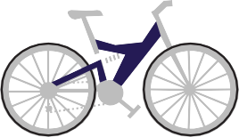


What Is Money?
In the context of the desert example, this means that you might be more inclined to drink all the water right away, even if it means that you won’t have any left for later. This is because the thirst you feel right now is more pressing than the potential thirst you might feel in the future.
On the other hand, if you choose to ration the water and drink it slowly over time, you are demonstrating a lower time preference. This means that you are willing to wait to satisfy your thirst and improve your chances of survival. The concept of opportunity cost is closely related to the idea of scarcity and time preference.
Today’s Choice
Now
Later
Buying a $7 strawberry smoothie
Spending $7 another way
Beneﬁting from
regularly saving $7
Opportunity cost refers to the value of the next best alternative that you give up when you make a decision. Every decision involves trade-oﬀs.

Slide 27
Why Do We Need Money?

Slide 28

Why Do We Need Money?
Money is one of the greatest instruments of freedom ever invented by man.
Friedrich Hayek
27

Slide 29
Why Do We Need Money?
Why do we need money?
Who controls money?
What is money?
What gives money its “value”?
28

Slide 30
Welcome to
BitKwa Bitcoin Diploma

